Slide 1

Customer Retention
E-commerce
Submitted by-
Anurag Kumar

Slide 2
ABOUT DATA
Given Dataset have 269 rows and 71 attributes or columns.
Data set has no NA values.
Majority of columns are categorical except one which is pin code.
It consists information about different features which help retention of e-commerce customers.
Here main aim is to Data Analysis and get insights about what features help in customer retention.

Slide 3
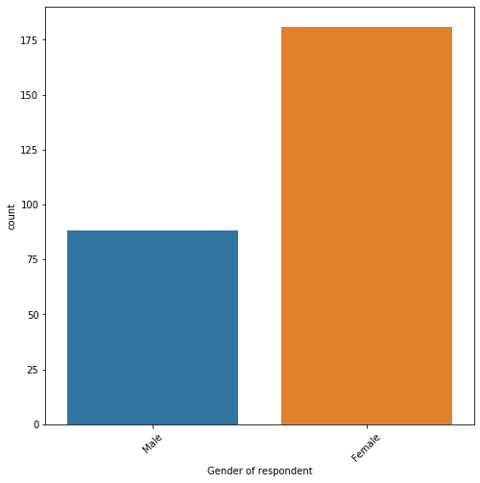
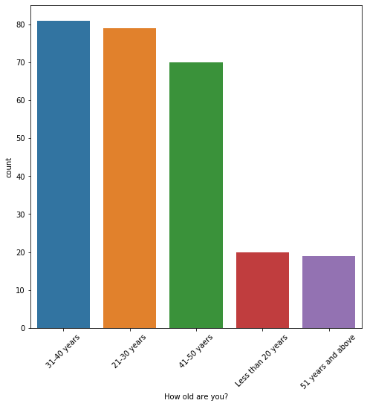
Gender and Age Group

Slide 4
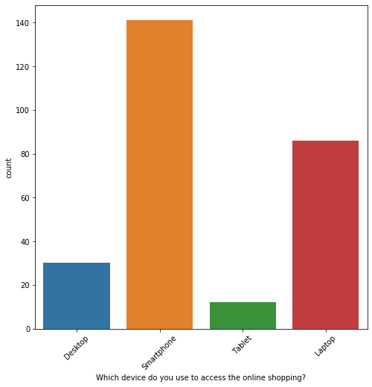
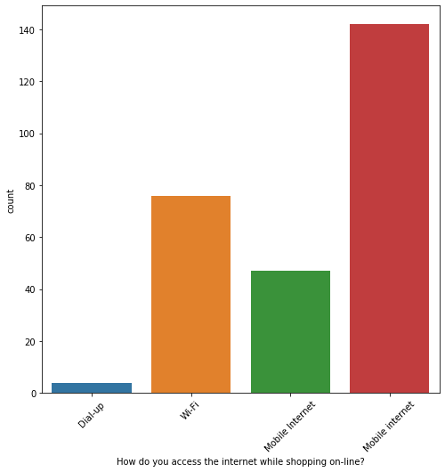
Devices and Internet
Smartphone used by majority
Mobile Internet used by most of users.

Slide 5
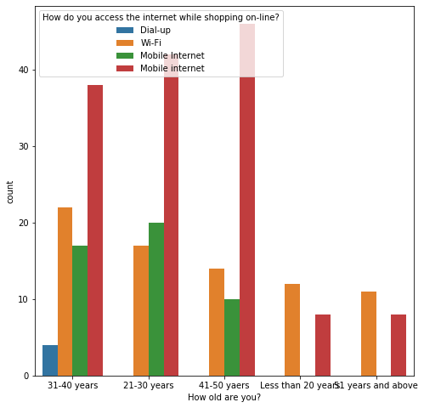
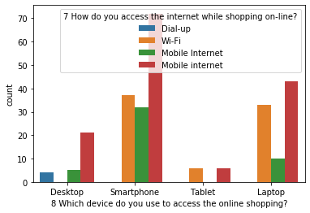
Internet access

Slide 6
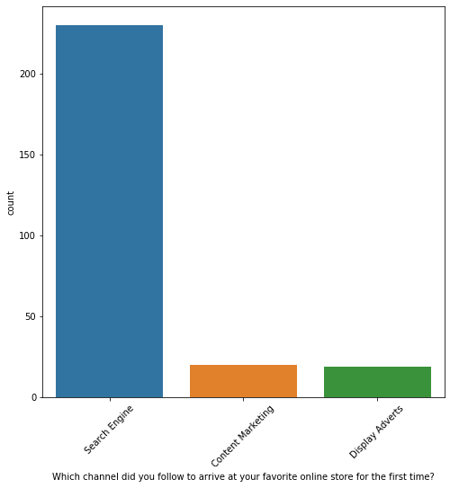
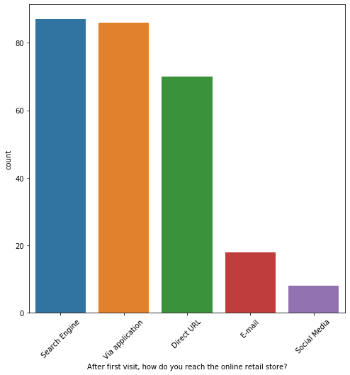
Channels to arrive at Online Store
First time user mostly use search engine
After first use both search engine and applications used by users.

Slide 7
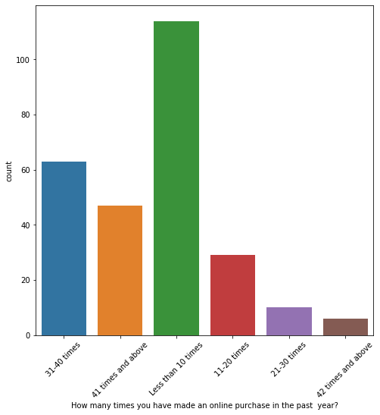
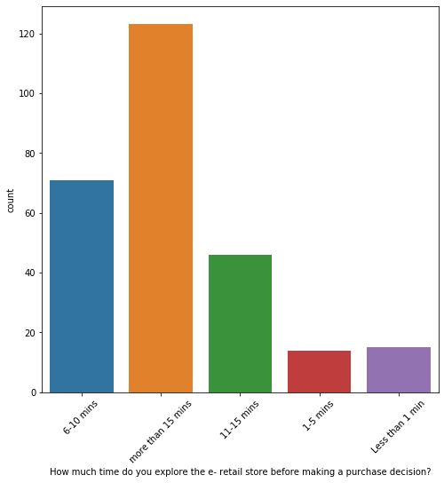
Online Purchase Last Year
And
Explore e-retail before making purchase

Slide 8
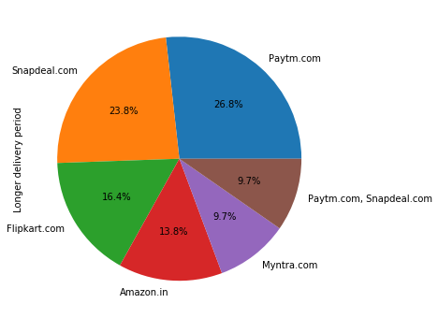
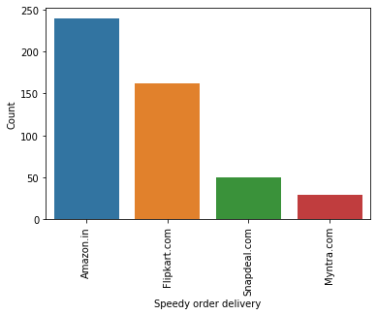
Delivery Speed

Slide 9
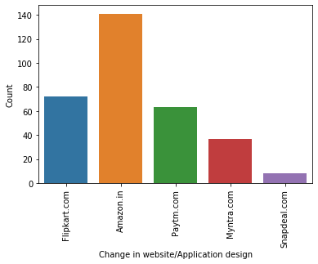
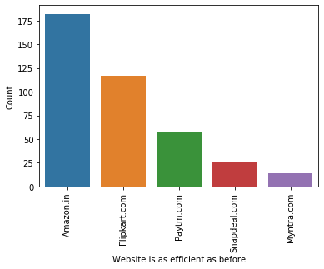
Website Design and Efficiency

Slide 10
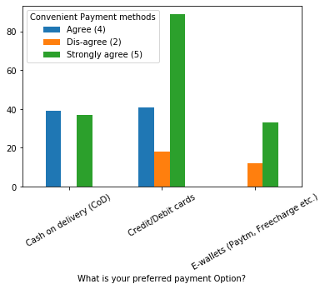
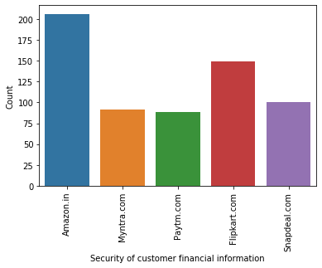
Payment Option and Financial Information

Slide 11
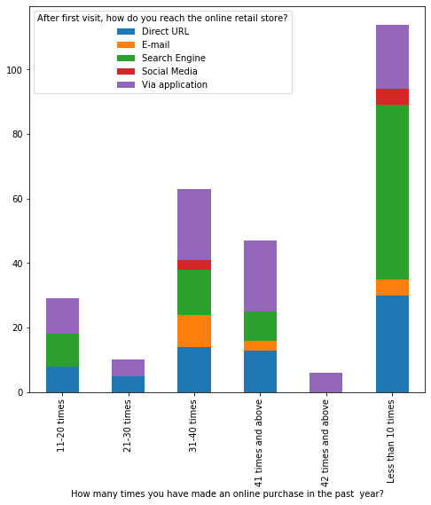
Number of time online purchase and How you reach online store

Slide 12
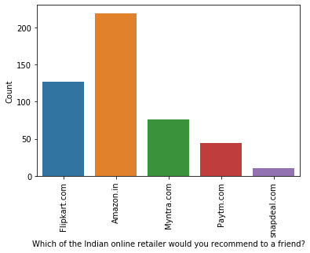
Recommendation by Users

Slide 13
Summary
Female is the largest number of user; the greatest number of customer comes from age group of 31-40
Most of the user in smartphone category uses Mobile Internet while in Laptop there are both chunk of mobile internet and Wi-Fi users.
Majority of respondents are shopping online above 4 years
Smartphone is most preferable means for online shopping
Search Engine is favorite channel to arrive online store first time
But after first time visit most reaches online retail via both search engine and application equally
People explore more than 15 times before making purchase decision
Large chunk of respondents pay via credit/debit card, 2nd comes COD and third E-wallet which means people prefer online pay.
Reason among majority of those who abandon after selecting items because best alternative offer, promo code not appliable and change in price.
People seek more information on listed seller and product being offered.
Ease of navigation on website and loading and processing speed is one of the important reason behind users retention.

Slide 14
Summary….
When comes to website design Amazon and then Flipkart is performing much better compared to rest of others.
overall Amazon website is more efficient when compared with its competitors.
Majority of Indian Online retailers recommend Amazon and Flipkart to their friends.
Overall, after all analysis it comes to that Amazon is most preferred and then Flipkart as they are performing well on various criteria.

